Slide 1
Global warming
B. Archana

Slide 2
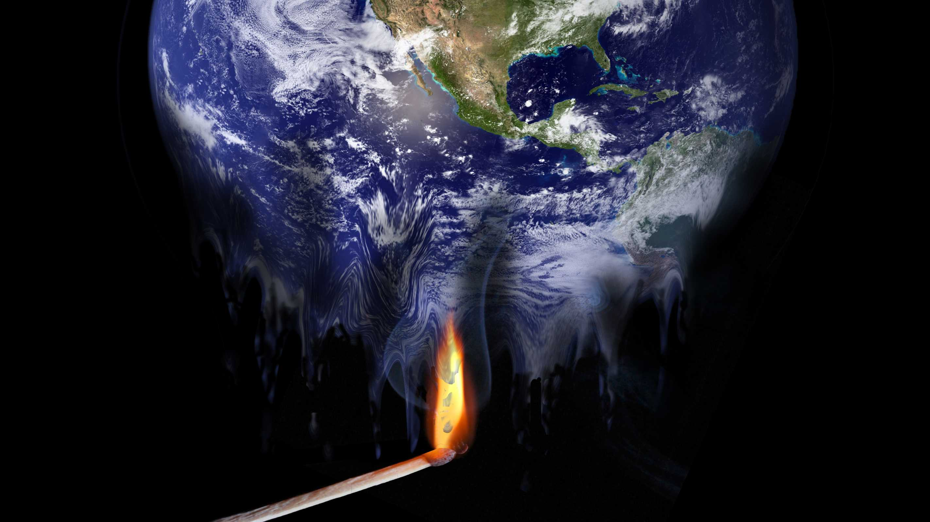
DEFINITION OF GLOBLA WARMING
Climate change refers to long-term shifts in temperatures and weather patterns. These shifts may be natural, but since the 1800s, human activities have been the main driver of climate change, primarily due to the burning of fossil fuels (like coal, oil, and gas), which produces heat-trapping gases.

Slide 3
CAUSES OF GLOBAL WARMING
VARIATION IN THE SUN’S INTERSITY
INDUSTRIAL ACTIVITY
AGRICUTLRAL ACTIVITY
DEFORESTATION
EARTH’S OWN FEEDBACK LOOP

Slide 4
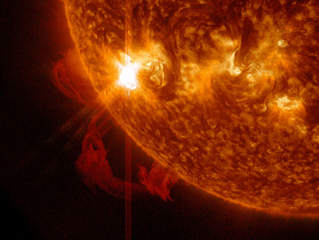
VARIATION IN THE SUN’S INTERSITY
The Earth receives its warmth from the sun, so it's reasonable to suspect that our home star may be one of the reasons for global warming. Although the amount of energy coming from the sun does vary and may have been responsible for warming in the past, however, NASA and the Intergovernmental Panel on Climate Change (IPCC) have ruled this out as a cause of the current warming trend.

Slide 5
INDUSTRIAL ACTIVITY

